Slide 1


Slide 2
Polymerase Chain Reaction (PCR)
Artificially multiplying segments of DNA through a series of repeated cycles of duplication using DNA polymerase

Slide 3
PCR ingredients
DNA sample – what you want amplified
Deoxynucleotide triphosphates (DNTPs)
Adenine
Thymine
Guanine
Cytosine

Slide 4
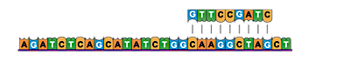
3. Primers
Short segments of DNA, complimentary to the targeted sequence of DNA
Primers bind to the single stranded DNA molecules and initiate replication by DNA polymerase

Slide 5
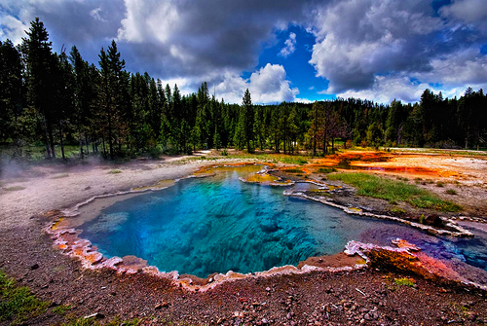
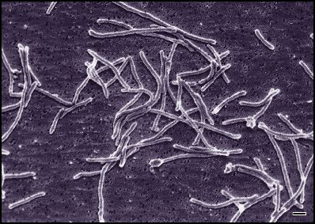
4. DNA polymerase
DNA polymerase from hot spring bacterium Thermus aquaticus
Taq polymerase
Heat stable enzyme
Optimum temperature for activity 75-80°C

Slide 6
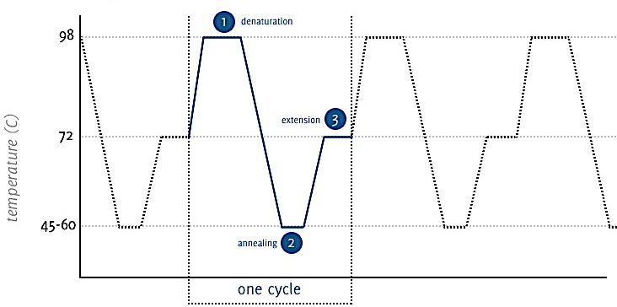
The PCR cycle

Slide 7
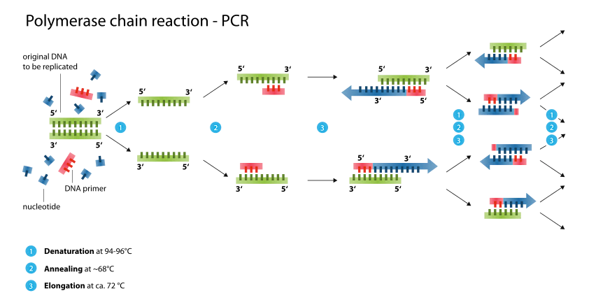

Slide 8
Polymerase Chain Reaction (PCR)
Every replication cycle results in double the amount of target DNA
After 35 cycles 2³⁵ = 34,359,738,368 copies of target DNA

Slide 9
Activity
Connect: Virtual Lab
Take notes on:
Denaturing
Annealing
Elongation

Slide 10
Applications of PCR
Detect hereditary diseases
Target gene of interest, amplify, sequence
Sickle-cell anaemia, PKU, cystic fibrosis
Detect viral diseases
Forensic science
Single drop of blood, semen or strand of hair
Determine relationships between humans and their ancestors
Small amounts of DNA are extracted from fossils

